Slide 1



Data Compression
Dr: Mahmoud Gamal
Eng: Hossam El-sokkary

Slide 2

Our Team
Name | ID
Ziad Ashraf Ibrahim | 20221369225
Ziad Ashraf Hafez | 20221374025
Ali Mohammed Elsayed | 20221449583
Nourhan Mohammed Fathy | 20221452411
Wesam Fathy Masoud | 20221451271
Mirna Samir Mohammed | 20221450912
Shahd Ahmed Saad Amin | 20221452998
Claudia Alves
Everest Cantu
Olivia Wilson
Aaron Loeb

Slide 3

Overview
Introduction
Techniques
Implementation In Python
Calculations Compression Techniques
GUI
Result

Slide 4




Introduction
Develop a python application with a decent graphical user
interface of all the lossless data compression techniques
(Run length encoding, Huffman encoding, Arithmetic encoding,
Golomb encoding and LZW encoding) .
The application inputs any text message from the user, and
then it encodes this message using every single technique

Slide 5



Techniques
Assigns shorter codes to symbols that occur more
frequently.
• Letter having higher probability will have smaller
codeword..
Golomb
Run length
Huffman
Arithmetic
• Variable length code for integers.
• It is a practical and powerful implementation of Run
Length Encoding of binary streams.
• The simplest method of compression.
• The general idea behind this method is to replace
consecutive repeating occurrences of a symbol by one
occurrence of the symbol followed by the number of
occurrences
• Tag = <index in dictionary>
• ASCII code: A: 65, B:66
Find the probability for each symbol, calculate
low_range, high_range of symbol.

Slide 6

Implementation In Python

Slide 7
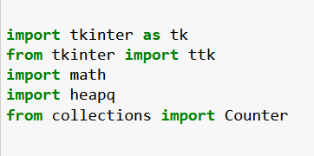

Libraries
tkinter and ttk enable you to create graphical user interfaces for desktop applications.
math provides a wide range of mathematical functions and operations.
heapq allows efficient implementation of priority queues for sorting and organizing elements based on their priority.
Counter simplifies counting and frequency analysis of elements in collections.
imports several libraries in Python.
the benefits of each of these libraries:

Slide 8
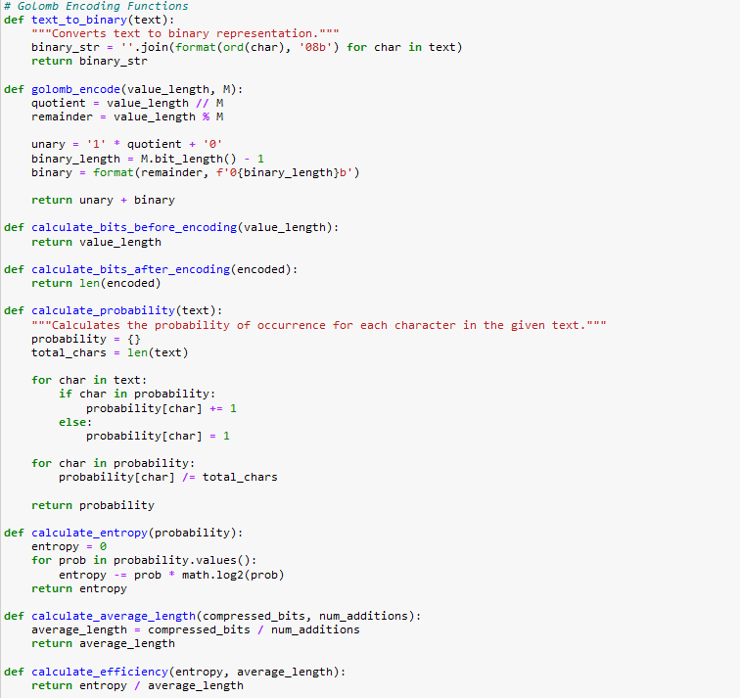
Golomb Encoding
text_to_binary(text): function converts a given text into its binary representation by converting each character to its ASCII value and then to an 8-bit binary string.
The golomb_encode: function performs Golomb encoding on a value length using a parameter M. It divides the value length by M to obtain a quotient and a remainder, which are then encoded using a unary code and a binary code.

Slide 9
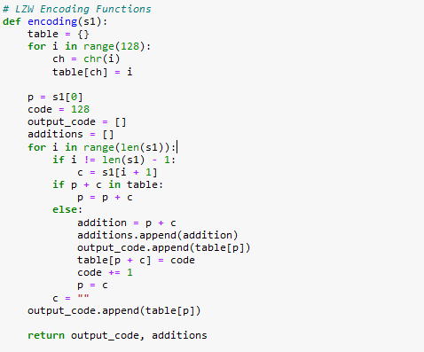
LZW Encoding
LZW encoding by building a dictionary dynamically based on the input string and generating a sequence of codes that represent the compressed data.
During the encoding process, an initial dictionary is created, mapping each ASCII character to its corresponding index. The algorithm iterates over each character in the input string and checks if the concatenation of the previous character p and the current character c exists in the dictionary. If it does, the algorithm updates p to be the concatenation p + c. If the concatenation is not in the dictionary, a new entry is added to the dictionary. The current code value of p is added to the output code list, and the dictionary is updated with the new entry. The code value is incremented for the next entry, and p is updated to c. After the loop ends, the code value for the last character p is added to the output code list.
The function returns the output code list, which represents the compressed data in the form of codes. It also returns the additions list, which contains the additional entries added to the dictionary during encoding. These additional entries are necessary for proper decoding.

Slide 10

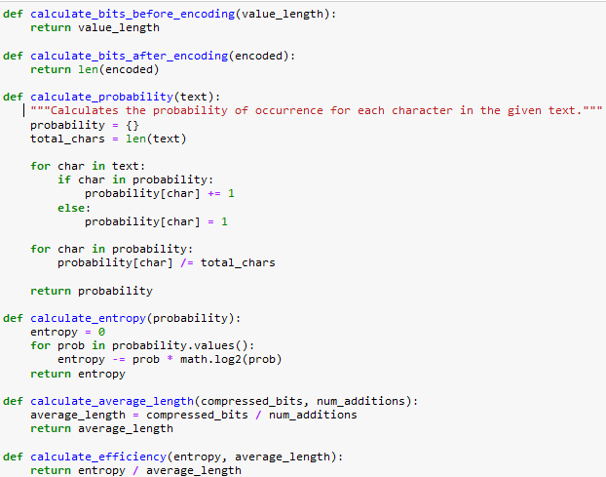

Calculations Compression Techniques
02
03
measuring the compression ratio, average length, and efficiency of the compression to analyze the compression performance of Golomb and LZW encoding on a given text
01

Slide 11
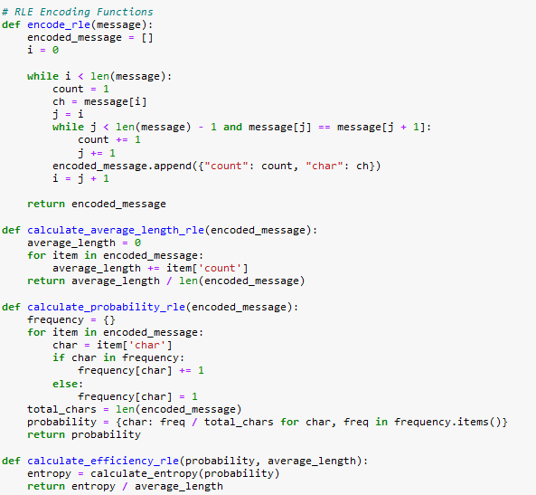
Huffmen Encoding
The encode_rle function takes an input string and performs RLE encoding on it. It iterates through the characters of the input string and counts consecutive occurrences of the same character. It then stores the count and character in a dictionary and appends it to the encoded_message list. The function returns the encoded_message list, which represents the RLE-encoded representation of the input string.
measuring the average length ,probability , and efficiency of the compression to analyze the compression performance of RLE encoding on a given text

Slide 12
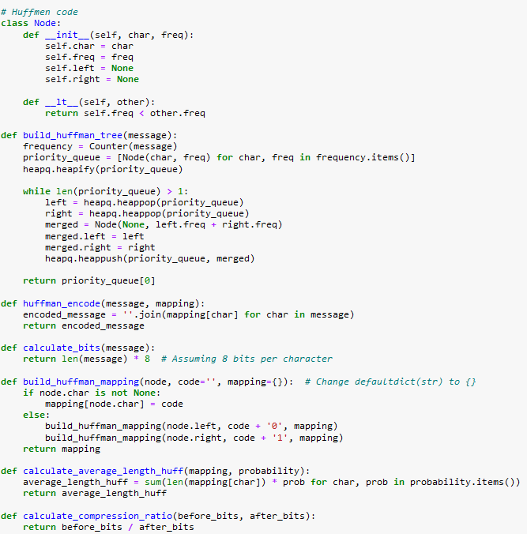
RLE Encoding
The Node class represents a node in the Huffman tree and contains information about the character and its frequency, as well as references to its left and right child nodes.
The build_huffman_tree function builds a Huffman tree based on the frequency of characters in the input message. It creates nodes for each character-frequency pair and uses a priority queue (implemented as a heap) to merge nodes with the lowest frequencies until a single root node remains.
The huffman_encode function encodes a given message using a pre-built mapping dictionary that assigns Huffman codes to characters. It iterates through the characters in the message and retrieves their respective codes from the mapping, concatenating them to form the encoded message.

Slide 13
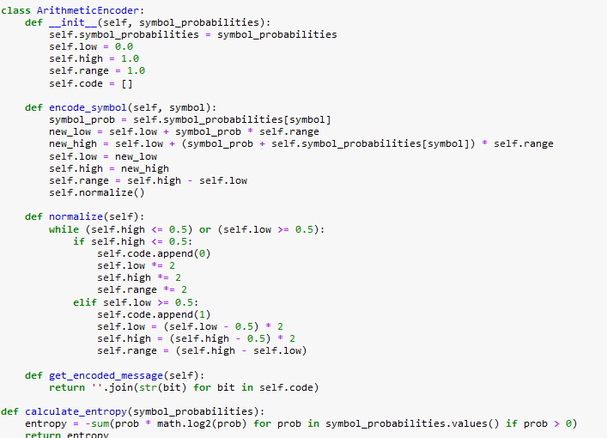
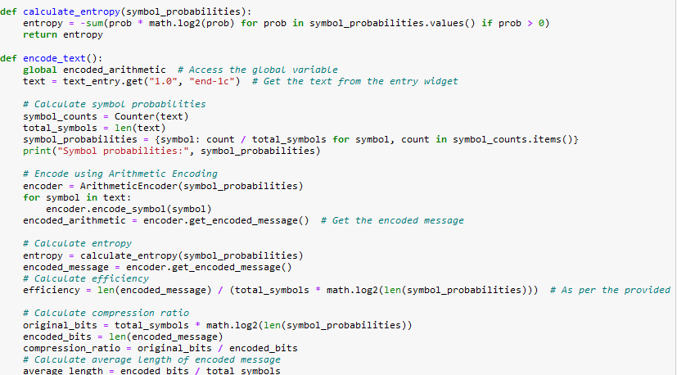
Arithmetic Encoding

Slide 14
Arithmetic Encoding
The provided code implements the arithmetic encoding algorithm for text compression. It includes the ArithmeticEncoder class, which is responsible for encoding symbols based on their probabilities. The class maintains the low, high, and range values during the encoding process and stores the binary code generated.
The encode_symbol method updates the low, high, and range values based on the probability of the input symbol. It also calls the normalize method to ensure the values are within the appropriate range.
The normalize method adjusts the low and high values to fall within the range (0.5, 1) or (0, 0.5). If necessary, it appends a '0' or '1' bit to the code and adjusts the values accordingly.
The get_encoded_message method returns the encoded message as a string by joining the bits in the code list

Slide 15
Arithmetic Encoding
The calculate_entropy function calculates the entropy of a probability distribution based on the symbol probabilities provided.
The encode_text function performs the encoding process for a given text string. It calculates the symbol probabilities, creates an instance of the ArithmeticEncoder class, encodes each symbol, and retrieves the encoded message. It also calculates the entropy, efficiency, compression ratio, and average length of the encoded message.
the code provides a basic implementation of arithmetic encoding for text compression, including encoding symbols, calculating entropy, and evaluating compression-related metrics.

Slide 16
GUI & Result

Slide 17
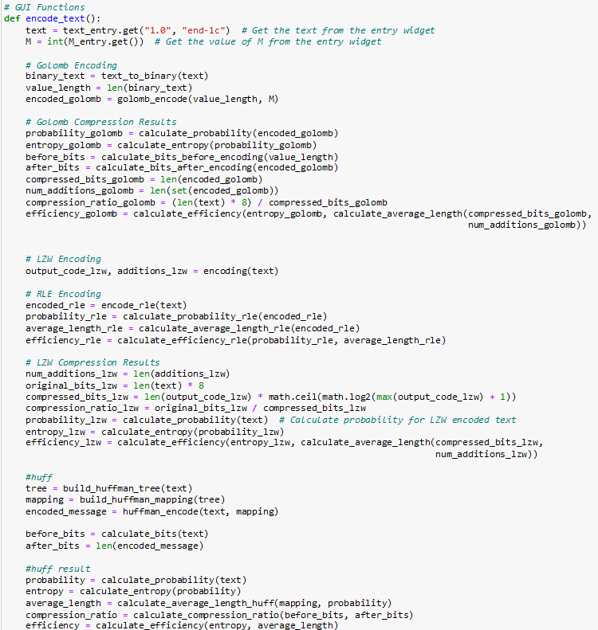
GUI
GUI function for performing various encoding techniques on text input. It includes Golomb encoding, LZW encoding, RLE encoding, and Huffman encoding. The code calculates several metrics and statistics related to each encoding technique, such as compression ratio, efficiency, entropy, and number of bits.

Slide 18
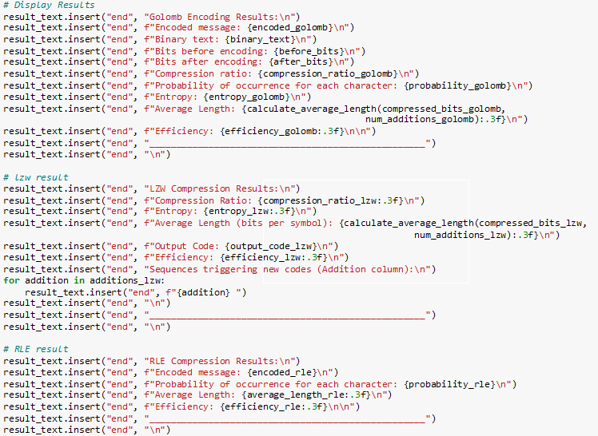
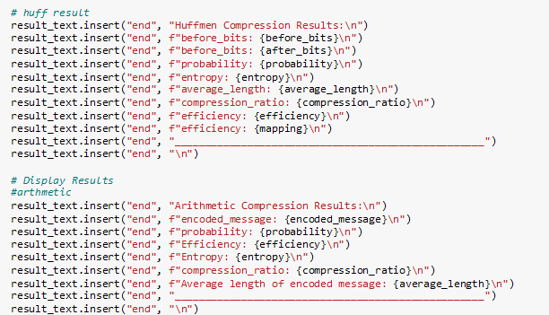
GUI

Slide 19
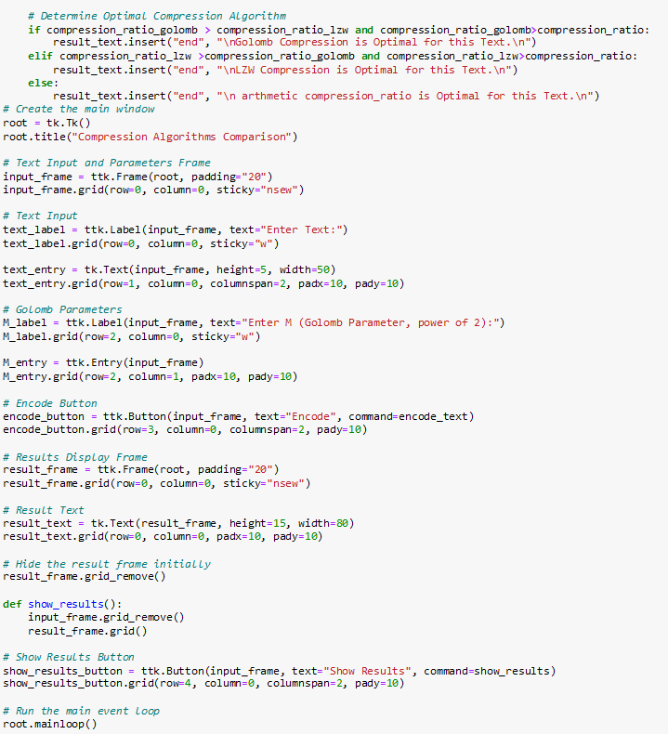
Optimal Compression Algorithm

Slide 20
THANK TOU

